Slide 1
Introduction to Machine learning
Dr. Suraiya Zabeen

Slide 2





















Introduction about me
PhD
in Aerospace Materials 2011
BSc in Materials Engineering
Notes:
Good evening everyone, Fellow toastmaster,
I am someone who is passionate about learning and teaching. I went ahead with learning how to learn.
Let us delve deeper into our brain and see how our brain works.

Slide 3
L
Intro..
Learning outcome
What is machine learning? Components of ML.
Data Science Methodology
Types of Machine Learning
Introduction Linear regression model
Libraries used for machine learning
Implementation of linear regression using
scikit-learn

Slide 4
Intro..
1. Your background 2. What industry are you interested in? 3. Your expectation from this class

Slide 5
ACTIONABLES - PLEASE COMPLETE BEFORE CLASS STARTS
DOWNLOAD VSCODE
04
CLONE THE REPO
01
Download the content repo from GitHub on your terminal using git clone command. Familiarise yourself with the content.
VSCode is the application in which we will write all of our code. Again, we will be using this from the moment we start class.
DOWNLOAD CONDA
RUN A PYTHON NOTEBOOK IN VSCODE
05
02
Conda is a software for installing Python code that other people have written (a Python package manager)
This is the format of the notebooks we will be going through throughout the course. Please make sure it works on your machine before class starts.
03
MAKE A GITHUB ACCOUNT
06
CREATE AN ACCOUNT IN KAGGLE
If you haven’t already, make a GitHub account. We will be using it from the moment we start.
07
JOIN THE LINKEDIN GROUP

Slide 6
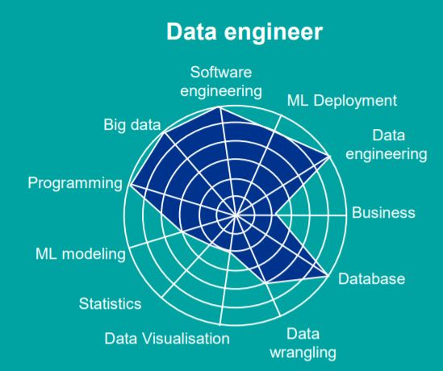
Skills required for different roles in DS ML industry

Slide 7
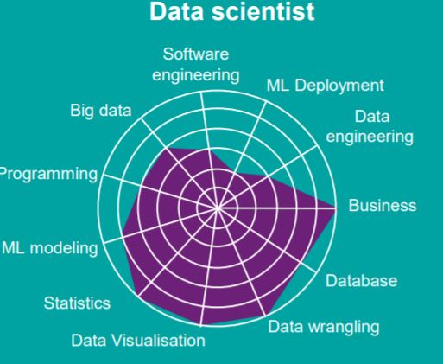
Skills required for different roles in DS ML industry

Slide 8
What is Machine Learning?
Machine Learning
AI
Deep Learning
Algorithms that parse data , learn from it , and then apply what they’ve learned to make informed decisions. They use human extracted features from data and improve with experience
Algorithms that mimic the intelligence of humans , able to resolve problemsin ways we consider “smart”. From the simplest to most complex algorithms.
Neural Network algorithms that automatically learn the important features in the data. Able to adapt by repetitive training to uncover hidden patterns and insights
Using Data to Predict Answers

Slide 9
What is Machine Learning
A machine learning algorithm is one which is able to learn from data to increase it's performance at some task.
"A computer program is said to learn
from experience
with respect to some class of tasks
and performance measure
if its performance at tasks in T, as measured by P, improves with experience E." - Tom Mitchell
E
T
P

Slide 10
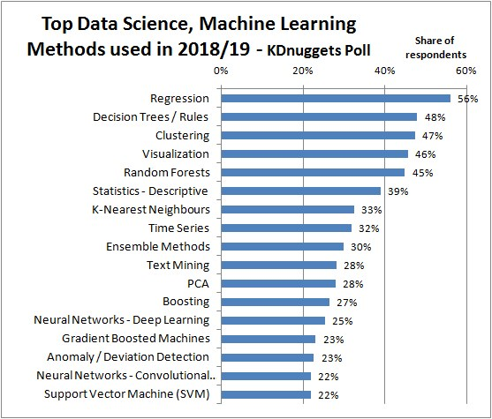
APPLICATIONS

Slide 11


Machine Learning Applications
Health Care
Marketing
Banking and Financial Market and services
Diagnosis and disease identification
Medical imaging diagnostics
Digital Consultation
New drug discovery
Manufacturing
Retail and E- commerce
Predictive maintenance - equipment failure
Implementation of safety rules
Quality Control
Controlling energy Consumption
Inventory management
Notes:
https://www.soleblogger.com/best-machine-learning-applications-for-web-designing-building/

Slide 12

Generative adversarial network (GAN)

Slide 13
Data Science Methodology
Business understanding
Analytic
Approach

Slide 14
Data Science Methodology
Business understanding
Analytic
Approach
Data Requirements
Business Understanding
Data Collection

Slide 15
Data Science Methodology
Business understanding
Analytic
Approach
Data Requirements
Business Understanding
Data Collection
Data Understanding
Data Preparation

Slide 16
Data Science Methodology
Business understanding
Analytic
Approach
Data Requirements
Business Understanding
Data Collection
Evaluation
Data Understanding
Modeling
Data Preparation

Slide 17
Data Science Methodology
Business understanding
Analytic
Approach
Data Requirements
Feedback
Business Understanding
Deployment
Data Collection
Evaluation
Data Understanding
Modeling
Data Preparation

Slide 18
The general framework for ML algorithms
Almost all machine learning algorithms consist of 4 components:
the data
the model
the criterion
the optimiser

Slide 19
Types of Machine Learning Problems
1. Supervised
2. Unsupervised
3. Semi-supervised
4. Reinforced Learning

Slide 20
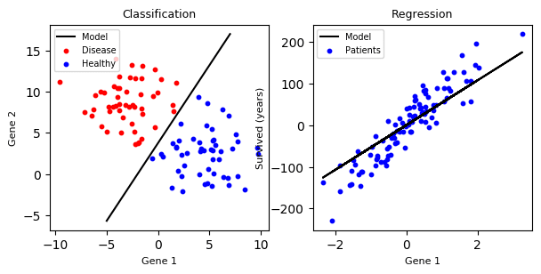
Types of Machine Learning Problems
Supervised
Regression
Continuous output / Price/Temp
Classification

Slide 21
Types of Regression Model
1. SIMPLE REGRESSON
LINEAR
2. MULTIPLE REGRESSION
LINEAR
NON-LINEAR
NON-LINEAR

Slide 22
The Linear Regression model
Label
Linear Regression model
Feature

Slide 23
Linear Regression model
bias
Prediction
weights
Feature

Slide 24
Linear Regression predicts weighted, shifted combinations of the features

Slide 25

Example - Data
Number of Rooms
Area
Age
X = [X⁽¹⁾ , X⁽²⁾ , X⁽³⁾ … X^{(m)} ]
X^{(i)} =
y^{(i)} =
Price
4
1000 sqft
32
X⁽³⁾ =
SARAH

Slide 26
Example - Model
4
10 sqft
32
If w = [ 10, 5, 0] and b = 2
X⁽³⁾ =
4
10
32
[ 10, 5, 0]
2
92
Predicted price

Slide 27
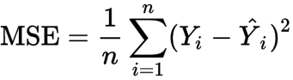
Evaluation : The performance criterion for linear regression
Target Output
= predictions
Feature
Mean Squared Loss ,
Notes:
https://www.kaggle.com/hely333/eda-regression

Slide 28
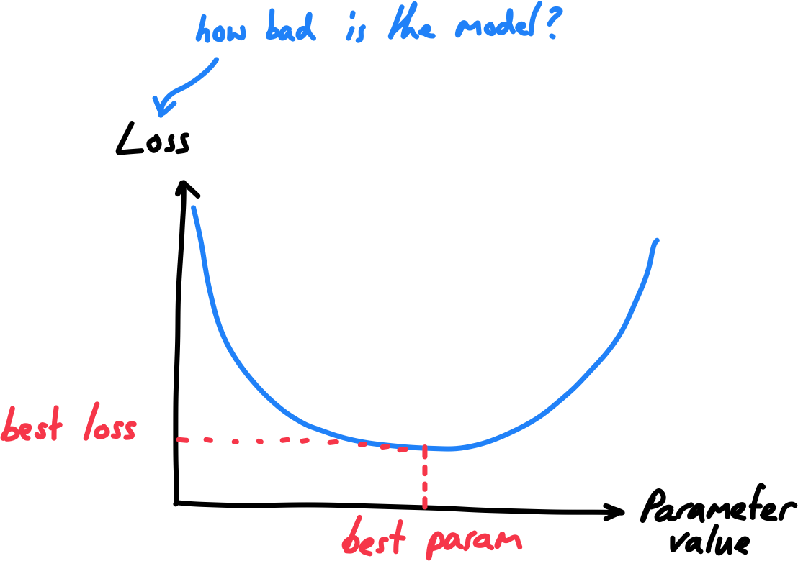
Optimization - Strategy to improve performance
Data
Model
Evaluation - model performance
Optimization

Slide 29






Python Libraries for Machine Learning

Slide 30
Useful Pandas Commands
Import pandas as pd
df = pd.read_csv (for reading a file)
df.to_csv(r'Path where you want to store the exported CSV file\File Name.csv’) for Saving a file
df.head() View the first few lines of file
df.describe Find the count, mean, min, max, STD
df.corr() correlation
df.columns()
df.shape
Df.dtypes

Slide 31
Build the Model
The steps to building and using a model are:
Define: What type of model will it be? A decision tree? A regression model , a classification.
Fit: Capture patterns from provided data. This is the heart of modeling.
Predict: Just what it sounds like
Evaluate: Determine how accurate the model's predictions are.
Notes:
You will use the scikit-learn library to create your models. When coding, this library is written as sklearn, as you will see in the sample code. Scikit-learn is easily the most popular library for modeling the types of data typically stored in DataFrames.

Slide 32
Scikit learn
scikit-learn (abbreviated sklearn) is a high-level machine learning library containing:
machine learning algorithms
example datasets
data pre-processing & pipelines

Slide 33
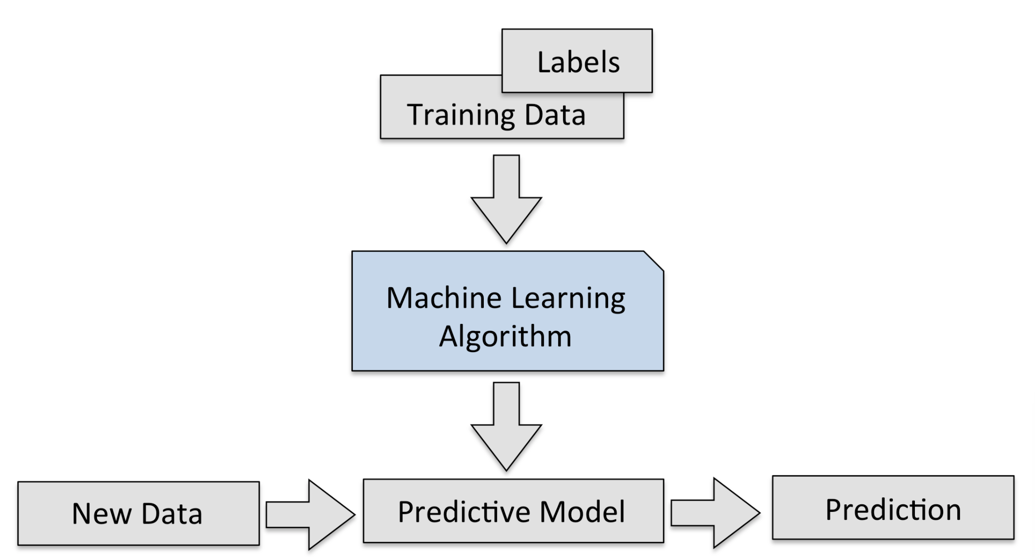
Linear Regression

Slide 34
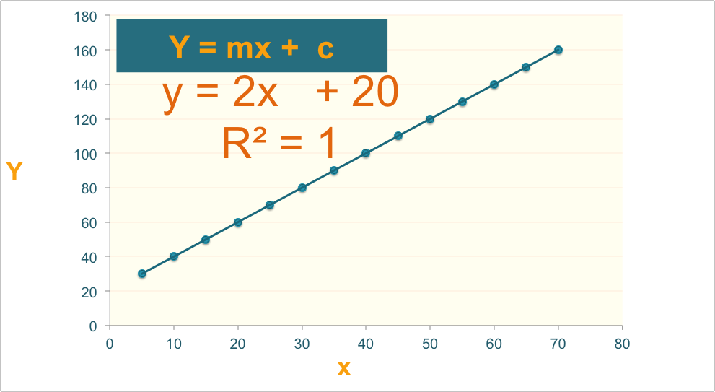
Linear Regression

Slide 35
Regression Algorithm
Ordinal Regression
Poisson Regression
Linear, polynomial, Lasso, Stepwise, Ridge Regression
Bayesian Network Regression
Neural Network Regression
Decision Forest Regression
Boosted Decision Tree Regression
K-nearest neighbors (KNN)

Slide 36
Data Preparation for modeling
Linear Assumption
Remove Noise
Feature Engineering
Remove Collinearity
Rescale Input

Slide 37
Model Evaluation
Regression Evaluation Metrics
Mean Squared Error (MSE),
Root Mean Square Error (RMSE) &
Mean Absolute Error (MAE)
R-squared (Coefficient of Determination)

Slide 38
Machine learning courses
https://www.kaggle.com/learn/overview
https://developers.google.com/machine-learning/crash-course
Andreww Ng’s Machine learning course
IBM Data Science Professional Certificate (PAID)
Machine Learning with TensorFlow on Google Cloud Platform Specialization
Machine Learning Data Science Course (Harvard University)
Fast.ai course

Slide 39
Upcoming Courses
Pandas for Data Analysis
SQL Basics for Data Science
Complete a project and add to your Github portfolio

Slide 40
Pandas for Data Analysis
Getting Started with pandas
Package Overview
Exploring panda
Essential Basic Functionality
Introduction to Data Structures
Comparison with Other Tools
User Guide

Slide 41
Upcoming Courses
Pandas for Data Analysis
Getting Started with pandas
Package Overview
Exploring panda
Essential Basic Functionality
Introduction to Data Structures
Comparison with Other Tools

Slide 42
Pandas for Data Analysis
User Guide
Indexing and Selecting Data
MultiIndex/Advanced Indexing
Merge, Join, and Concatenate
Reshaping and Pivot Tables
Working with Text Data, Missing Data, and Categorical Data
Nullable Integer Data Type
Visualisations
Computational Tools
Group By: Split-Apply-Combine
Time Series and Time Deltas
Stylings
Options and Settings
Enhancing Performance
Sparse Data Structures
pandas Ecosystem
Statistics and Machine Learning
Visualisation
IDE
Data Validation
Extension Data Types

Slide 43
Feature Engineering
Feature extraction

Slide 44

Flourishing Life
Home Courses Blog
Get Started
We help you launch your data science career
Learn More

Slide 45
Flourishing Life
Home Courses Blog
Get Started
Python Foundation
Data Analysis with Python Pandas
SQL Basics for Data Science
Machine learning Level-2
Deep Learning
Courses
Machine Learning
Level-1
Amazon Web service Machine Learning Foundation
Apache Spark for Machine Learning and Data Science
Fast Data Visualization with Python

Slide 46
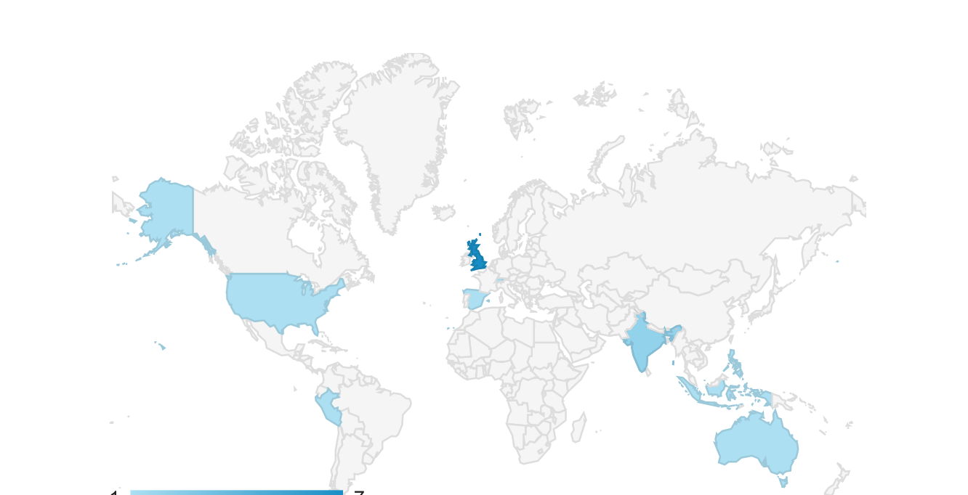
Courses
Flourishing Life
Home Courses Blog
Get Started
Where our students are from

Slide 47
Flourishing Life
Home Courses Blog
Get Started
Learn More
Get Started

Slide 48
Courses
Home Courses Blog
Get Started
Launch your career
Blog
Showcase
Try our neural network projects.
Check what you can build
Resources and Scholarships

Slide 49

Courses
Home Courses Blog
Get Started
Resources and Scholarships
Get Started

Slide 50
Courses
Home Courses Blog
Get Started
N=118 | Predicted No | Predicted Yes
True Negative (NO) | TN = 74 | FP = 6 | 80
True Positive (Yes) | FN = 27 | TP = 11 | 38
 | 101 | 17

Slide 51
Data preparation and visualization
Dr. Suraiya Zabeen

Slide 52
What is going to be covered
Data Cleaning
- Check if there is missing values in your data
- String Manipulation
Application of regular expression
Pandas groupby
Creating functions, lambda function, applying functions

Slide 53
Learning Outcome
Data visualization
Histogram
Choropleth map
Bar plot

Slide 54
EVENTS calendar

